Slide 1
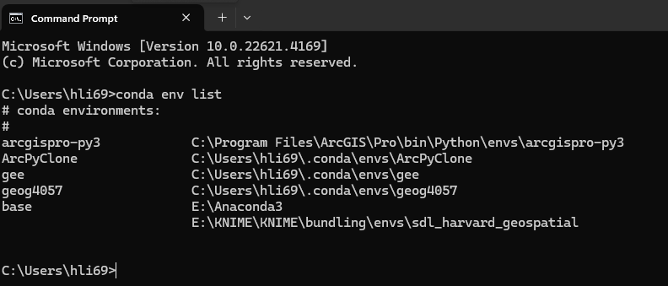
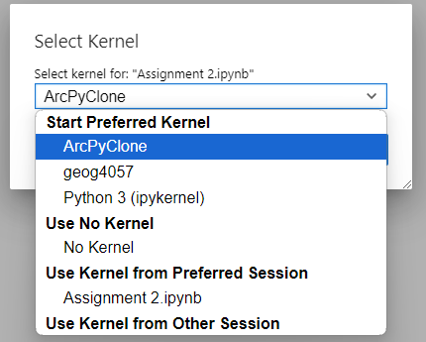
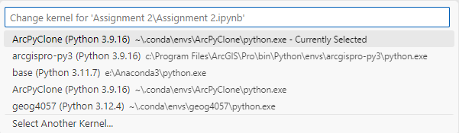
ArcPyClone environment has been created.
Kernels can be selected in Jupyter Notebook.
Kernels can be selected in VS Code.

Slide 2
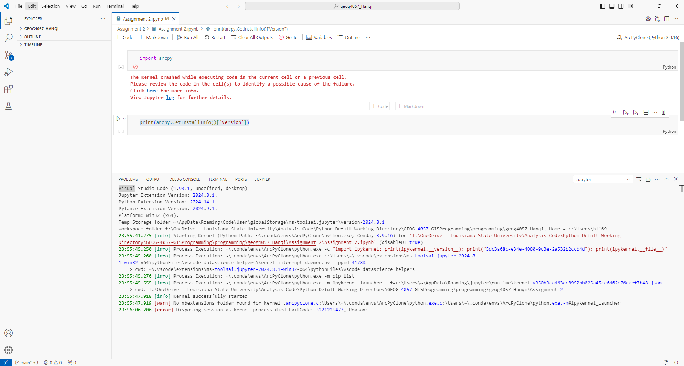
Command “import arcpy” cannot been executed with the kernel ArcPyClone in VS Code.

Slide 3
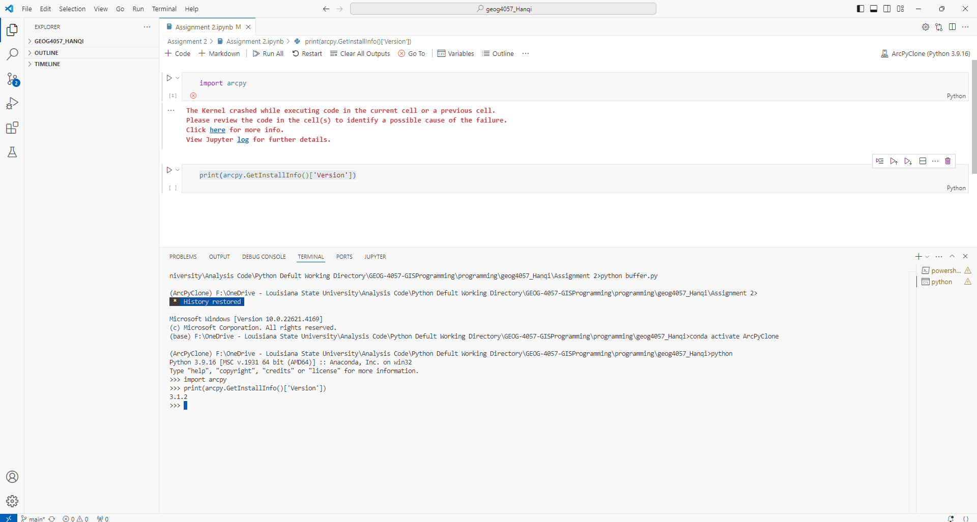
Command “import arcpy” can been executed in the Terminal with the kernel ArcPyClone in VS Code.

Slide 4
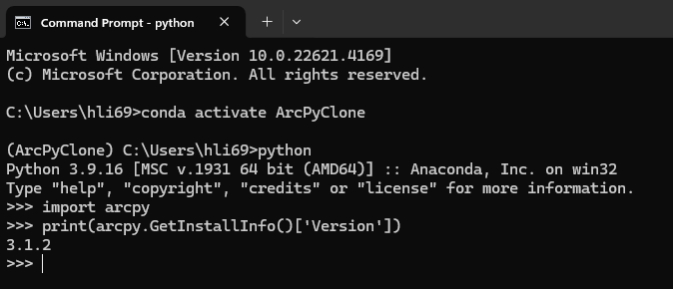
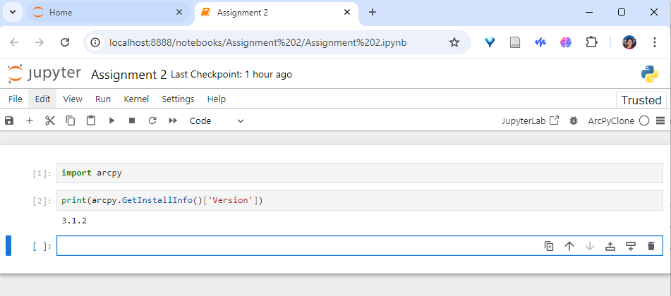
Command “import arcpy” can been executed in the Terminal with the kernel ArcPyClone.
Command “import arcpy” can been executed in the Jupyter Notebook with the kernel ArcPyClone.

Slide 5
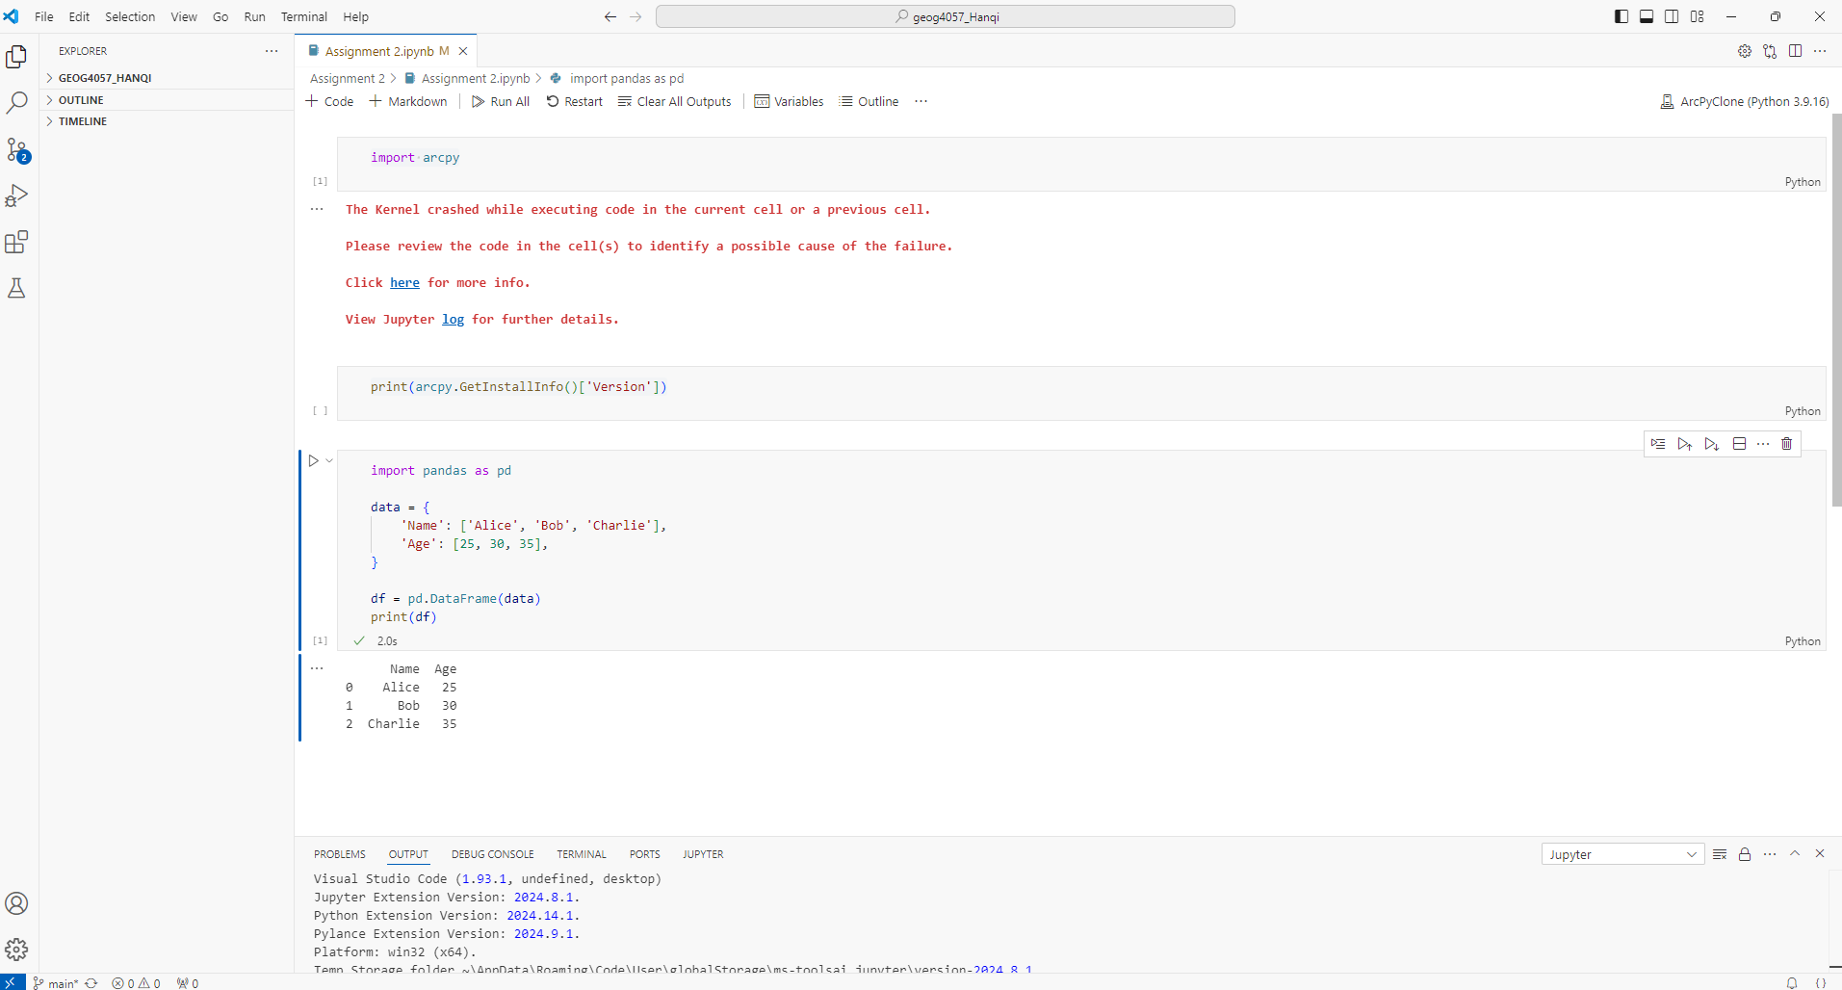
Try another command. Command “import pandas” cannot been executed with the kernel ArcPyClone in VS Code.

